Slide 1

AI Transparency & Bias Auditor (AITA)
A machine learning project focused on identifying, evaluating, and mitigating algorithmic bias across multiple domains.
By Aflah C
PGA 30

Slide 2

Introduction
Artificial Intelligence (AI) plays a major role in today’s decision-making systems across sectors such as hiring, finance, and education. While AI improves efficiency, it can also inherit hidden biases from historical or unbalanced data. These biases may lead to unfair or discriminatory outcomes, affecting specific individuals or groups. To ensure ethical and transparent AI systems, it is essential to detect, measure, and reduce algorithmic bias in machine learning models.
Problem Statement
Machine learning models often make decisions influenced by biased training data. This results in unfair predictions — for example, preferring one gender in hiring, favoring certain races in loan approvals, or giving better results to private school students. The main challenge is to identify, quantify, and mitigate these biases without compromising model accuracy. Therefore, this project aims to build a Bias Auditor system that evaluates and improves fairness in AI models using fairness metrics and mitigation techniques.

Slide 3






Dataset Overview
Multi-Domain Analysis
Comprehensive evaluation across three key domains — hiring, loans, and education — where algorithmic bias can directly impact real-world opportunities and outcomes.
Hiring Dataset
Loans Dataset
Students Dataset
2K synthetic records with gender, age, degree, experience, skills, and hiring outcomes.
2K synthetic records containing race, income, credit score, loan amount, and approval status.
2K synthetic records including school type, study hours, parental education, previous grades, and pass/fail results.
Designed to detect and analyse gender bias in recruitment.
Focused on identifying racial bias in financial decision-making
Used to explore educational bias based on school background.

Slide 4



Model Development:
Random Forest
Feature Engineering
Cross-Validation
A Random Forest Classifier was used as the base model for prediction. It is an ensemble learning method that builds multiple decision trees and averages their predictions for stable results.
Protected (sensitive) attributes such as gender, race, and school type were identified. Categorical variables were encoded into numeric form, and all datasets were cleaned and imported from MySQL into Jupyter Notebook for model training. (Purpose: To prepare fair and structured data for modeling.)
Data was divided into training and testing sets using stratified sampling to ensure balanced representation of demographic groups. Model performance was evaluated using accuracy, precision, recall, F1-score, and ROC-AUC metrics. (Purpose: Reliable performance measurement and fairness evaluation.)
Parameters: 100 trees, max depth = 10, and balanced class weights to maintain fairness across classes. (Purpose: Provides good accuracy and prevents model bias.)

Slide 5

Fairness Metrics
Demographic Parity Difference (DPD)
Measures the difference in positive prediction rates (e.g., approvals or selections) between protected groups such as gender, race, or school type.Smaller DPD → more equal opportunity between groups.(Used to detect if one group gets selected more often than another.)
Equalized Odds Difference (EOD)
Compares the true positive rates (how accurately the model identifies qualified candidates) between groups.Lower EOD → fairer model performance across demographics.(Used to check if accuracy or success rates differ between groups.)
Validation Approach
Fairness was evaluated using both DPD and EOD metrics for each model (Hiring, Loans, and Students).Fairness scores were compared before and after bias mitigation using the Fairlearn library.
Metric Thresholds
In fairness research, acceptable bias levels are:|DPD| < 0.1 and |EOD| < 0.1 (closer to 0 means higher fairness).In my project it showed clear improvement — especially in the Loans dataset, where both DPD and EOD dropped significantly after mitigation.

Slide 6
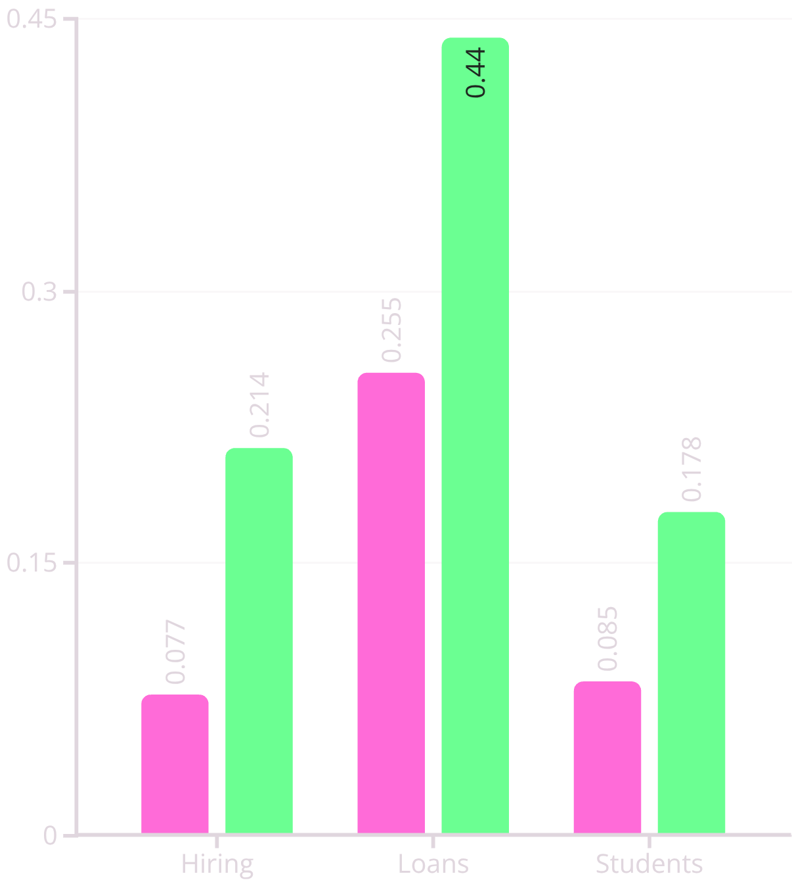


Results Before Mitigation
Bias Metrics by Dataset
Critical Bias Detected
All three datasets show fairness violations above acceptable thresholds (|DPD| and |EOD| > 0.1). The Loans dataset displayed the highest level of bias, requiring urgent mitigation.
Performance Impact
While model accuracy ranged between 51%–71%, the presence of strong bias made these models unsuitable for ethical deployment. Bias mitigation was therefore applied in the next phase.
DPD (Before Mitigation)
EOD (Before Mitigation)

Slide 7




Fairness Correction Process
Configure Fairlearn
Apply Constraints
Iterative Optimization
Initialized Fairlearn’s Exponentiated Gradient algorithm with fairness constraints. The model was trained again using Random Forest as the base estimator to optimize both accuracy and fairness. (Purpose: Set up the fairness-aware training pipeline.)
Fairness constraints were applied using Demographic Parity Difference (DPD) and Equalized Odds Difference (EOD) as optimization targets. The model adjusted its learning process to reduce bias across sensitive groups (gender, race, or school type). (Purpose: Guide the model to make more balanced predictions.)
Fairlearn performed multiple iterations to minimize bias while maintaining performance. This produced a new, fairer model where DPD and EOD scores decreased significantly, especially in the Loans dataset. (Purpose: Achieve balance between fairness and accuracy.)

Slide 8
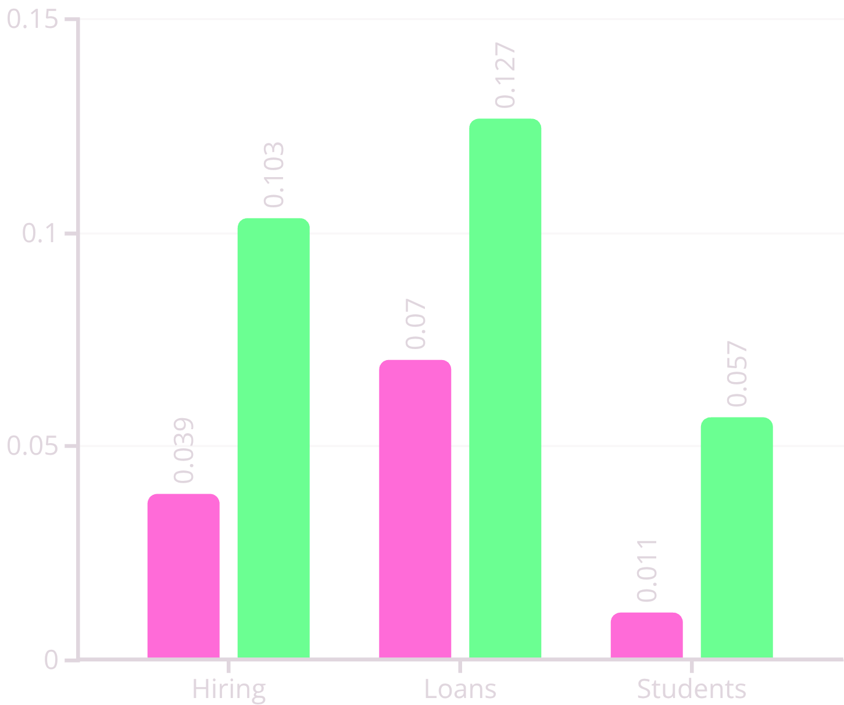
Post-Mitigation Results
Bias Metrics by Dataset
Conclusion
This project successfully demonstrated that machine learning models can be audited and improved for fairness.
The AI Transparency & Bias Auditor (AITA) framework helped identify, measure, and correct bias in synthetic datasets from hiring, education, and finance domains.
Using Fairlearn, bias was reduced without a major drop in accuracy — achieving a balance between performance and ethics.
The results prove that responsible AI is not only possible but essential for real-world applications.
DPD (After Mitigation)
EOD (After Mitigation)

